Slide 1
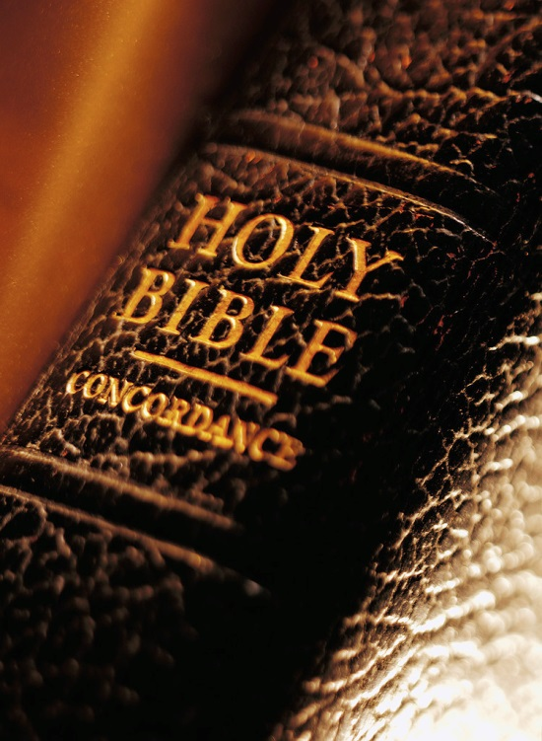
Expository Excerpts From Acts 2
(part 2; Acts 2:14-36)
All Verses Are From The NKJV Unless Noted

Slide 2
Acts 2 (previously)
Pivotal Chapter
Fulfillment of prophecy (Joel 2:28-32; Dan. 7:13, 14; 2:44; Is. 2:1-4)
Beginning of the church of Christ (Acts 2:47; 1 Cor. 12:13)
Terms of entrance given (Acts 2:21, 37, 38)

Slide 3
Acts 2 (previously)
2:1-11 – God Keeps His Promises
Holy Spirit baptism
Tongue speaking
2:12, 13 – Man’s Slow Heart

Slide 4
3) The Defense Of The Gospel (2:14-36)
Wisdom in answering the charge (2:14, 15)
A rash judgment against good (2:13)
The kind of judging Jesus condemned (Lk. 6:37-45)
Not against judging wrong-doers:
By civil authority (1 Pet. 2:13, 14)
By congregational authority (Matt. 18:16, 17; 1 Cor. 5:1ff; Titus 3:10; etc.)
By personal right (Lk. 6:39; 43-45; Matt. 7:1, 6, 15; 1 Cor. 5:11)

Slide 5
3) The Defense Of The Gospel (2:14-36)
Wisdom in answering the charge (2:14, 15)
The answer of scripture proves inspiration (2:16-21)
From the known to the unknown (2:22-24)
Known:
“miracles, wonders, and signs…as you yourselves also know” (2:22)
“have taken by lawless hands, have crucified” (2:23)

Slide 6
3) The Defense Of The Gospel (2:14-36)
Wisdom in answering the charge (2:14, 15)
The answer of scripture proves inspiration (2:16-21)
From the known to the unknown (2:22-24)
Unknown:
“Him, being delivered by the determined purpose and foreknowledge of God…” (2:23)
“whom God raised up, having loosed the pains of death…” (2:24)

Slide 7
3) The Defense Of The Gospel (2:14-36)
Wisdom in answering the charge (2:14, 15)
The answer of scripture proves inspiration (2:16-21)
From the known to the unknown (2:22-24)
Agreement of Davidic testimony (2:25-35)
David says “concerning Him” (25)
Prophecy cannot be about David (29)
Prophecy about the Christ (30, 31)
Jesus is the Christ that David spoke of (32)
The necessary inference (2:33-35)

Slide 8
“Therefore being exalted to the right hand of God, and having received from the Father the promise of the Holy Spirit, He poured out this which you now see and hear” (Acts 2:33)
HOLY SPIRIT
JESUS
SENT
BAPTISM
POURED OUT
Necessarily infers that Jesus ascended into the heavens and is at that right hand of God
APOSTLES
PEOPLE
“you now see and hear”

Slide 9
3) The Defense Of The Gospel (2:14-36)
Wisdom in answering the claim (2:14, 15)
The answer of scripture (2:16-21)
From the known to unknown (2:22-24)
Agreement of Davidic testimony (2:25-35)
The bold application (2:36)

Slide 10
“God has made this Jesus…both Lord and Christ” (Acts 2:36)
MESSIAH
JESUS
WOULD DIE (2:27)
WOULD RISE FROM DEAD (2:27)
WOULD ASCEND INTO HEAVENS (2:34, 35)
IS DAVID’S LORD (2:34)
DIED (2:23)
ROSE FROM THE DEAD (2:24, 32)
DID ASCEND, POURED OUT HOLY SPIRIT (2:33)
IS LORD AND CHRIST (2:36)

Slide 11
The Forcefulness Of Four
Holy Spirit baptism and the prophets prove apostolic inspiration
The testimony of the apostles, the empty tomb and the Psalms prove the resurrection of Jesus Christ
The testimony of the apostles, Holy Spirit baptism and the Psalms prove the ascension of Jesus Christ
Holy Spirit baptism and the Psalms prove that Jesus is “Lord” and “Christ”

Slide 12
In The Next Lesson:
The importance of the resurrection (Acts 2:31)
The desired response (Acts 2:37-41)

Slide 13
Will You Obey The Christ Your Lord?
Will you believe that Jesus is the Christ, the Son of God?
Will you confess that today?
“Simon Peter answered and said, ‘You are the Christ, the Son of the living God’” (Matt. 16:16)
Will you be willing to repent from all sin (Acts 2:38)?
Will you be willing to be baptized for the remission of sins (Acts 2:38)
Will you be willing to remain faithful to the Lord until death (Rev. 2:10)?

